Slide 1
To Airbnb or not to Airbnb
By Keith Sawyer

Slide 2



What Is The Problem
?
Should I Invest in
Airbnb in the USA?
Should I invest in
Airbnb in Europe?

Slide 3


In today’s world economy the investor has many investment
Opportunities.
With international travel being at all-time highs, Airbnb properties
have become a major avenue of investment.

Slide 4
This brings up two questions:
Does the investor stand to earn more Airbnb revenue in the United states or Europe?
Once a region is chosen, which features increase revenue the most?

Slide 5

Let’s take steps to tackle this problem!!
Gather current Airbnb data from nine cities across the United States and 9 cities in Europe
Clean and prepare the data for investigation
Create charts and other visuals to understand the patterns
Draw conclusions on revenue and key features
Scale down the ‘price’ feature since it has a much larger variance than the other features

Slide 6


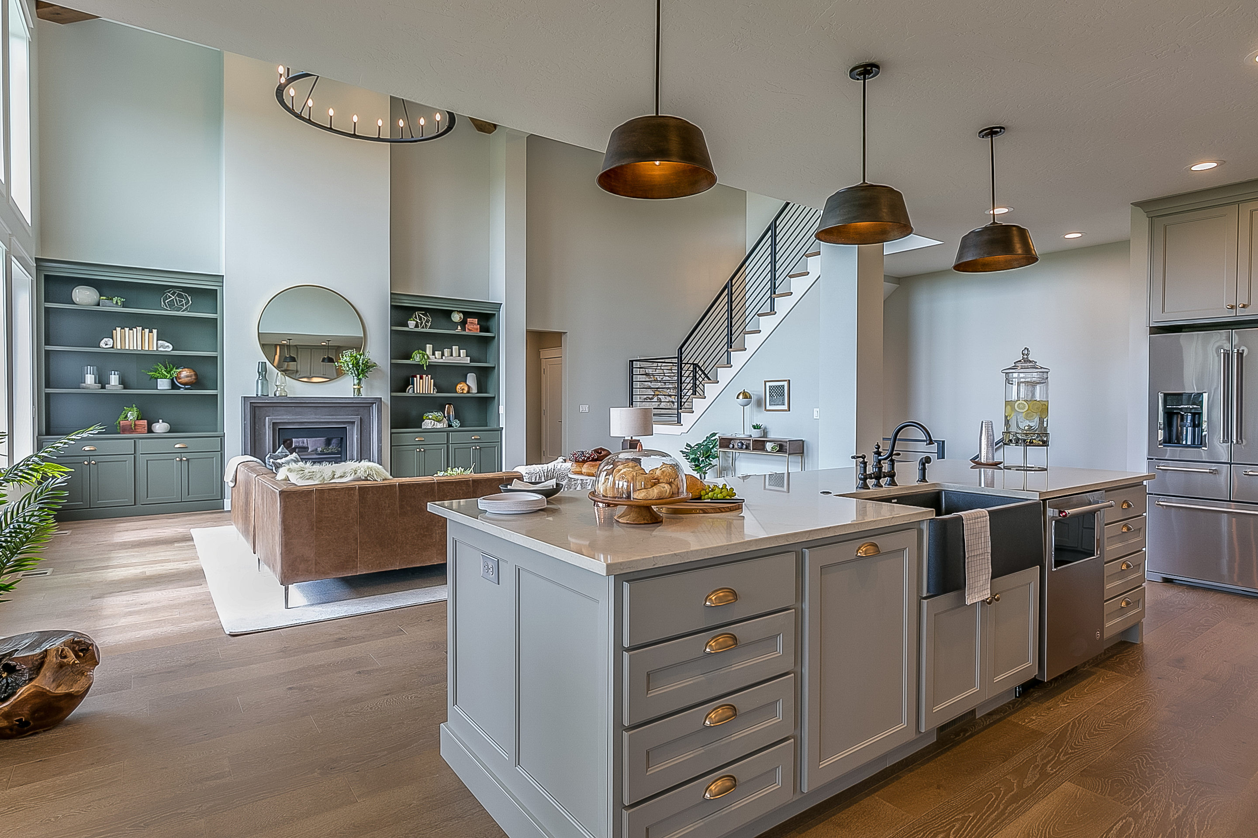
Time To Pick Cities!
From the US:
From Europe:
Asheville
Austin
Boston
Chicago
Las Vegas
Dallas
Los Angeles
Denver
New York City
Amsterdam
Barcelona
Berlin
Brussels
Copenhagen
London
Athens
Paris
Rome

Slide 7
These features were used in the investigation
Latitude | Private Room in Rental Unit | Room In Boutique Hotel
Longitude | Entire Condo | Entire Townhouse
Accommodates | Private Room In Home | Private Room in Townhouse
Bathrooms | Entire Home | Entire Vacation Home
Bedrooms | Private Room in Condo | Shared Room In Rental unit
Beds | Entire Serviced Apartment | Private Room
Price | Private Room in Bed and Breakfast | Hotel Room
Entire Home | Entire Loft | Shared Room
Entire Rental unit | Room In Hotel | Entire Home/Apartment
Source: Kaggle

Slide 8


Doing Heavy Lifting with Machine Learning Models
Linear Regression
Lasso Regression
Polynomial Regression
Gradient Boost Regression
Random Forest Regression
Let’s find the model that is best
suited for the data sets

Slide 9
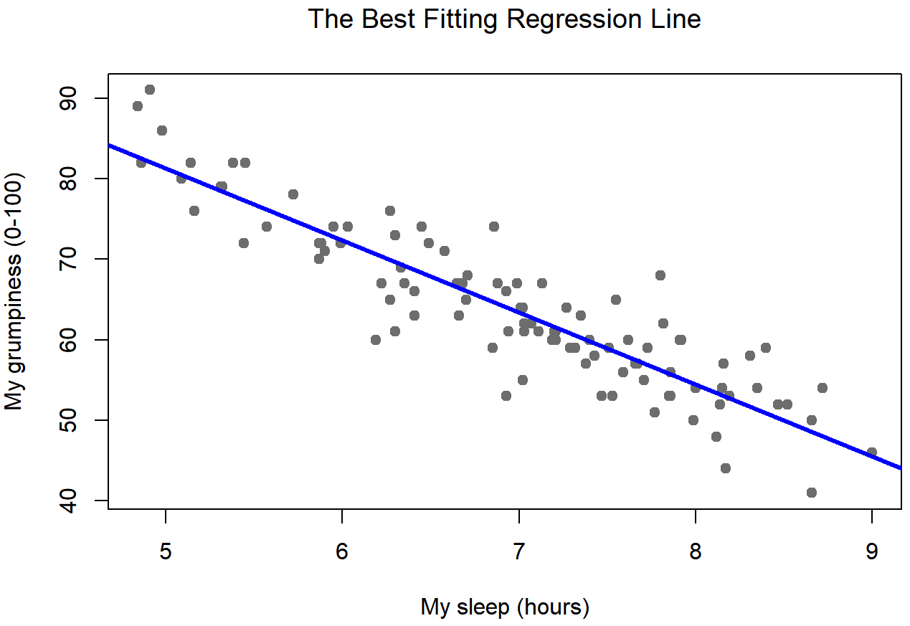
Linear Regression Model Summary
Hyperparameters:
None
Metrics used | Europe Results | United States Results
Negative Mean Absolute Error | -41.65 | -41.565
R-squared | .34 | .3368

Slide 10
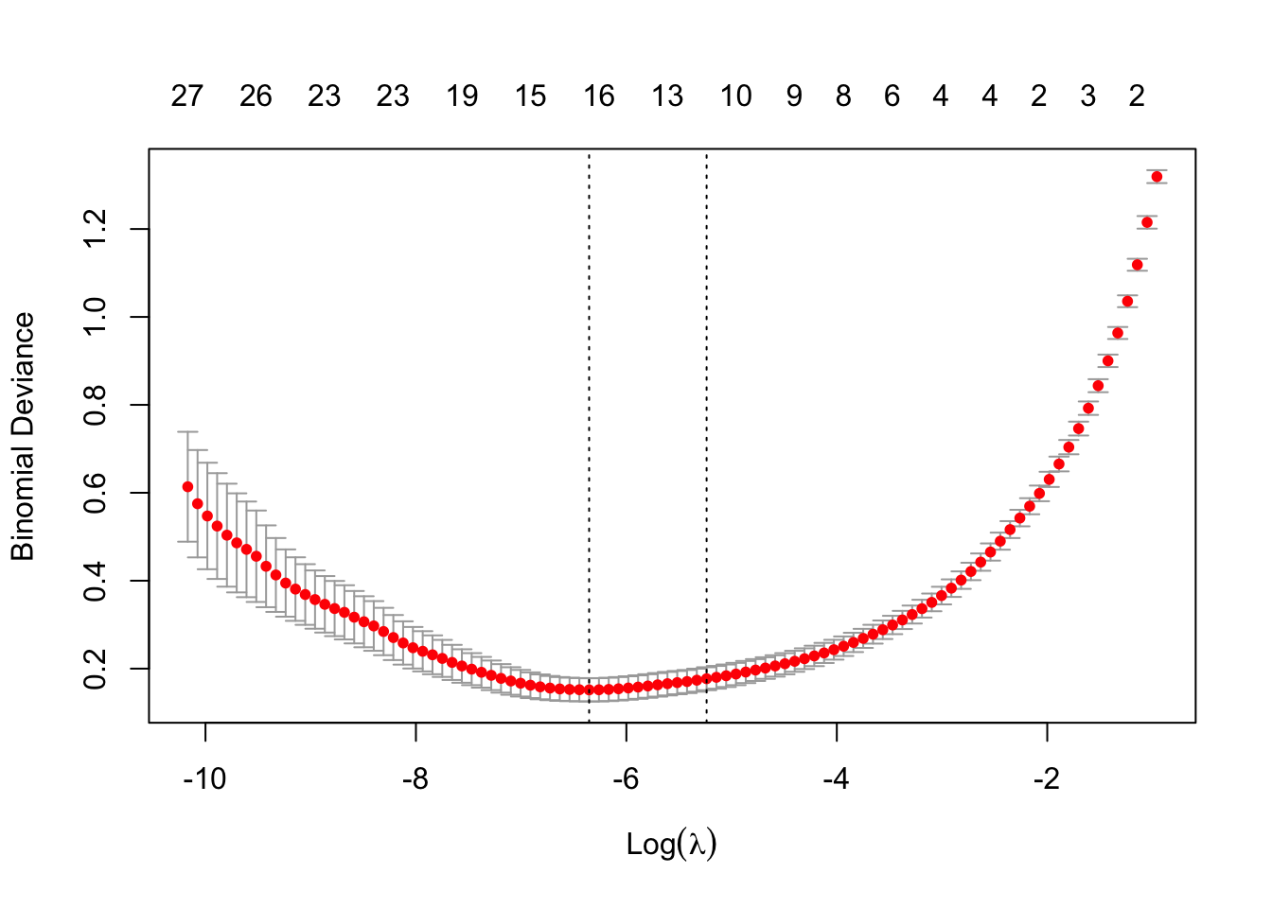
Lasso Regression Model Summary
Hyperparameter | European Dataset Value | United States Dataset Value
alpha | .001 | .01
Metrics used | Europe Results | United States Results
Negative Mean Absolute Error | -41.65 | -41.565
R-squared | .30 | .33

Slide 11
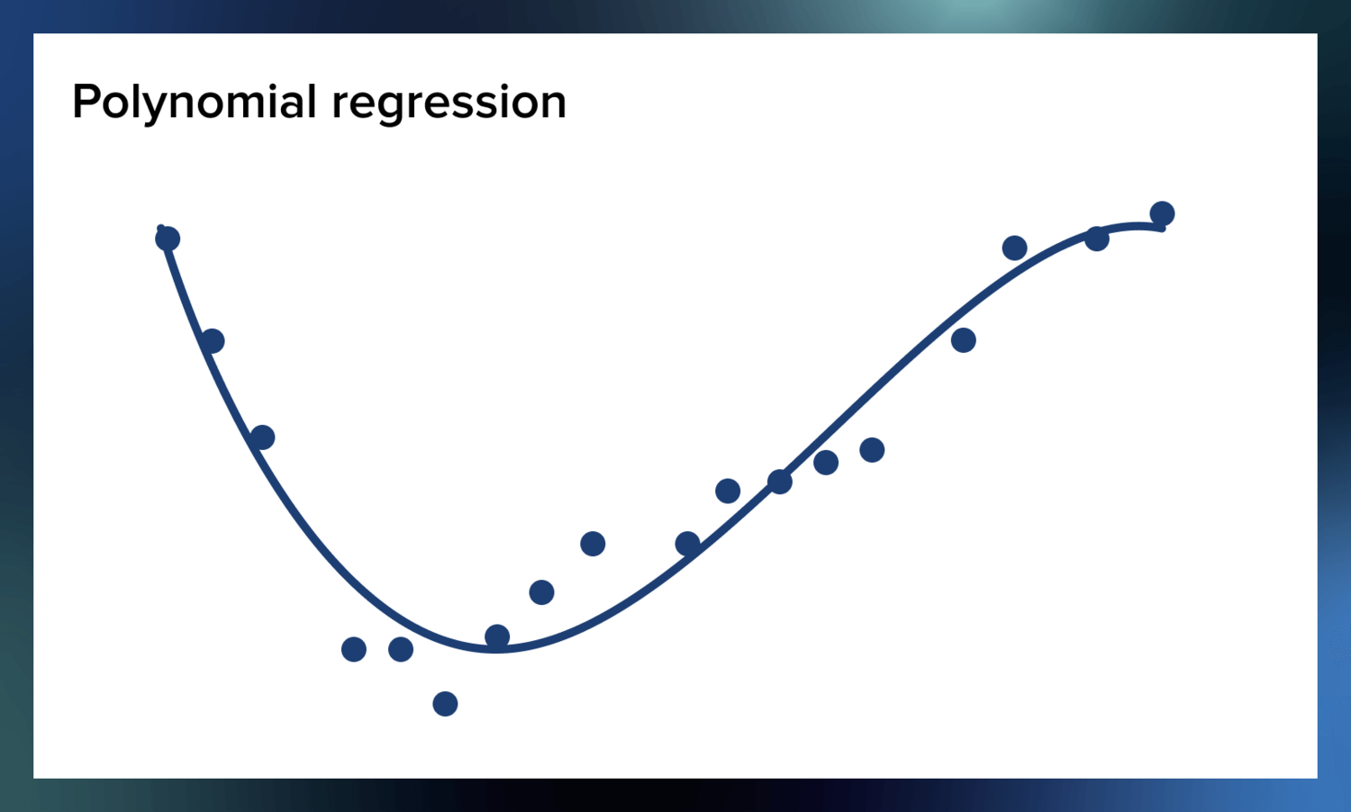
Polynomial Regression Model Summary
Hyperparameters:
None
Degree of Polynomial Model | European Dataset Value | United States Dataset Value
2 | 37.416 | 38.04
3 | 36.616 | 87.73

Slide 12
Gradient Boost Regression Model Summary
Model | Parameters | Results for Europe Dataset | Results for United States Dataset
1st | No Hyperparameters | R-squared = .464 | R-squared = .48
Model | Parameters | Results for Europe Dataset
2nd | N_estimators = 400 | R-squared = .464
 | Learning_rate = .1 | Negative R.M.A = -1834.645
 | Max_depth = 5
Model | Parameters | Results for Europe Dataset
3rd | N_estimators = 600 | R-squared = .5516
 | Learning_rate = .1 | Negative R.M.A = -1825.47
 | Max_depth = 5
Model | Parameters | Results for Europe Dataset
4th | N_estimators = 600 | R-squared = .489
 | Learning_rate = .01 | Negative R.M.A = -1979.37
 | Max_depth = 5
***No models were trained on US data
outside of default hyperparameters since
The European and US data structures are
Similar and not much was gained through
Setting hyperparameters for the European
Models. ***

Slide 13


Random Forest Regression Model Summary (Final Results)
Ah, but the forest……….
Hyperparameter | European Dataset Value | United States Dataset Value
Max_depth = 23 | R-Squared = .82 | R-Squared = .8952
This Photo by Unknown Author is licensed under CC BY-NC
These were the best results after training 22 models, where the Max depth ranged
from 2 to 23.
****
****

Slide 14

This Photo by Unknown Author is licensed under CC BY-SA

Slide 15
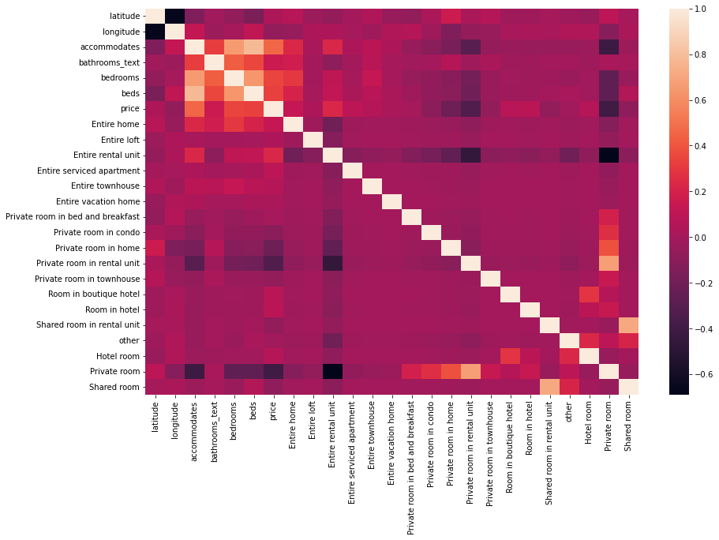
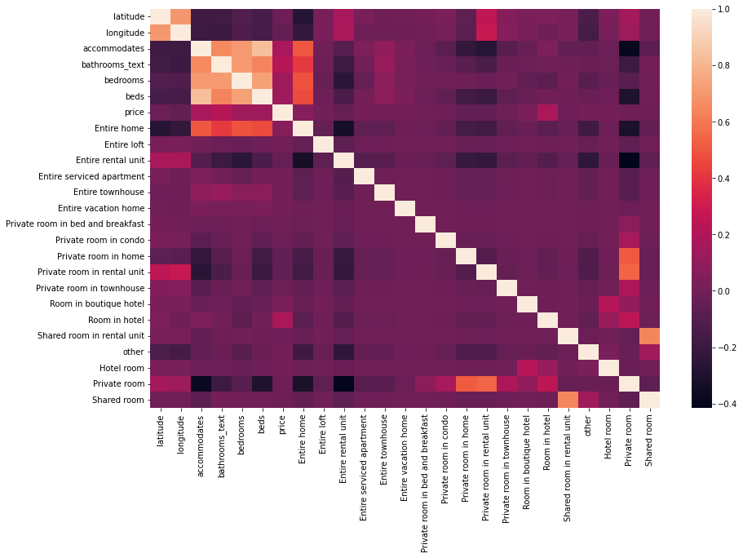
Heatmap of correlation of European Features
Heatmap of correlation of US Features
Price has a stronger correlation to accommodations,
bathrooms, bedrooms and beds in Europe than the US.
The ‘entire home’ feature is more important in relation to
accommodations, bathrooms, bedrooms and beds
in the US than in Europe.
The heat maps show that
Europe and the US are similar
in structure and correlation,
BUT…………..

Slide 16
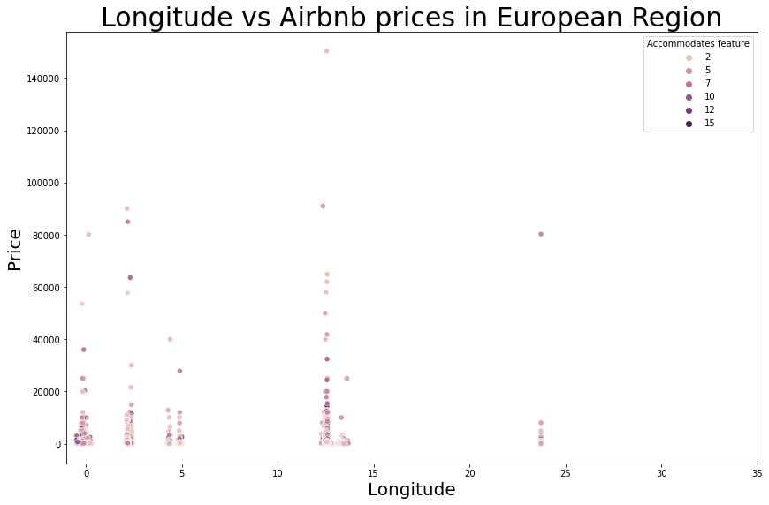
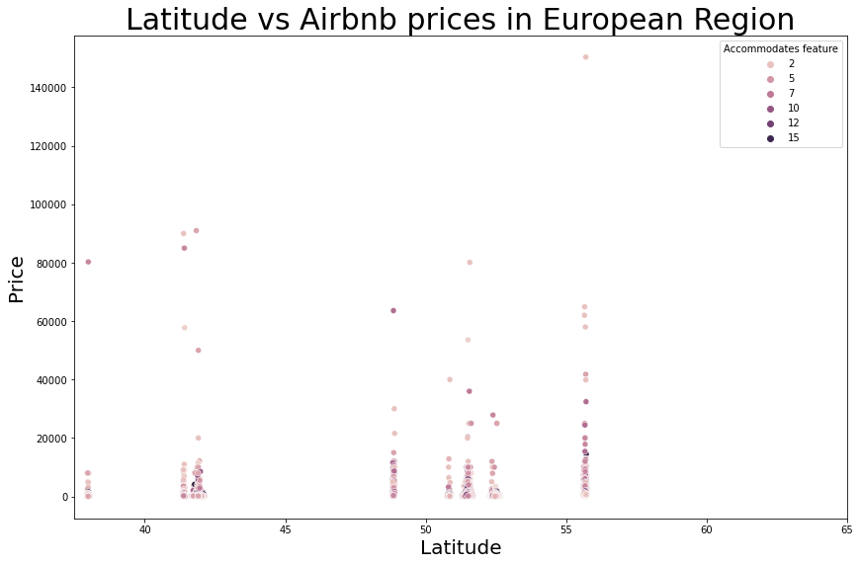
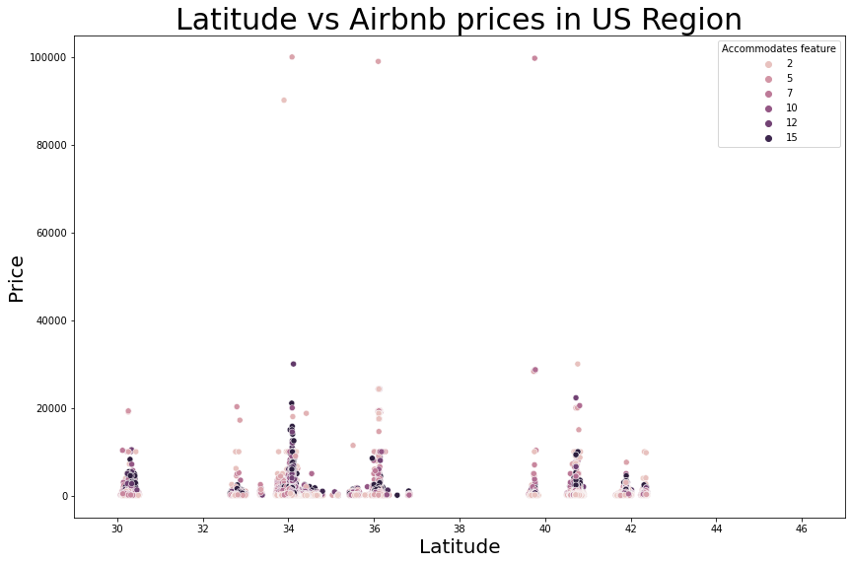
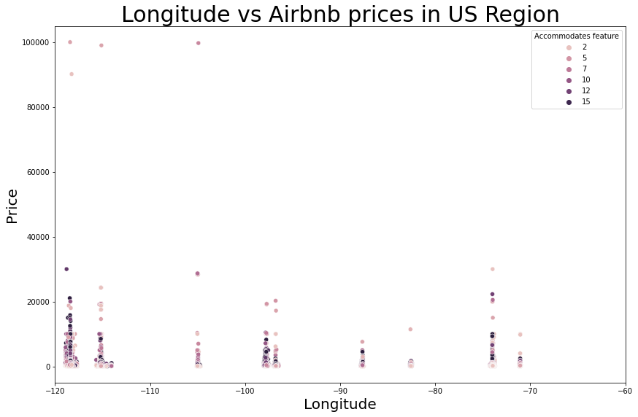
Price is not overly dependent
On location (latitude and longitude)
The US has prices mostly centered in the range
Between $0 and $20,000
Europe has a common range of prices between
$0 and $70,000
Individual properties tend to accommodate
more guests in the US than in Europe

Slide 17


RECOMMENDATIONS
Invest in Airbnb in Europe as they appear to yield a higher revenue
Focus more on renting out the entire rental unit as it is the most
positively correlated to price.
Put more capital into properties that accommodate between 2 and 7 people

